Slide 1
WELCOME
Third Executive Meeting on NMOOP
(25th October, 2016)
Groundnut and Progress of MM-I in A.P.
DEPARTMENT OF AGRICULTURE
ANDHRA PRADESH
1

Slide 2
MONTH WISE RAINFALL (in mm) June- Oct, 2016
.
10/24/2016
2

Slide 3
Major oil seed crops in AP (season wise AYP)

Slide 4
Area, Yield and Production of Groundnut in major districts of AP

Slide 5
Groundnut Productivity in AP and other Major States compared to All India
Kgs/ ha
III rank
XIV rank
XV rank
District | Kharif | Rabi | Total |  | District | Kharif | Rabi | Total
Krishna | 3412 | 2052 | 3006 |  | Visakhapatnam | 1395 | 1950 | 1569
Prakasam | 3246 | 2660 | 2929 |  | Srikakulam | 1170 | 1820 | 1490
Nellore | 2970 | 2525 | 2750 |  | Chittoor | 1144 | 2597 | 1280
Guntur | 2090 | 2790 | 2655 |  | Vizianagaram | 1042 | 2002 | 1228
West Godavari | 2090 | 2455 | 2354 |  | Kurnool | 908 | 1630 | 1021
East Godavari | 2090 | 2072 | 2074 |  | Anantapur | 719 | 2000 | 783
Kadapa | 1277 | 2452 | 1801 |  | State | 865 | 2329 | 1027

Slide 6
Rain fall in AP and Anathapuram district (ATP)

Slide 7
Groundnut area, yield and production for the last five years in AP

Slide 8
Protective irrigation through rain guns
Mandal wise mapping was done of frequent drought mandals based on the data base of last 12 years.
13,334 each of rain guns and sprinkles, 8053 oil engines and 3.5 lakh water carrying pipes.
Water supplying equipment is procured by Government investing Rs.160.54cr
20,000 lit of water was provided which equivalent to 5-7mm rainfall for each acre.
During 1st phase 4.02 lakh acres (up to 5-9-2016) and during 2nd phase 1.43 lakh acres (26-9-2016) was given protective irrigation of groundnut, redgram, blackgram, greengram, maize and chilies
80% of the cost of water transport through tankers and the cost of diesel for oil engine is born by the Government and only 20% of the cost is paid by the farmer.

Slide 9
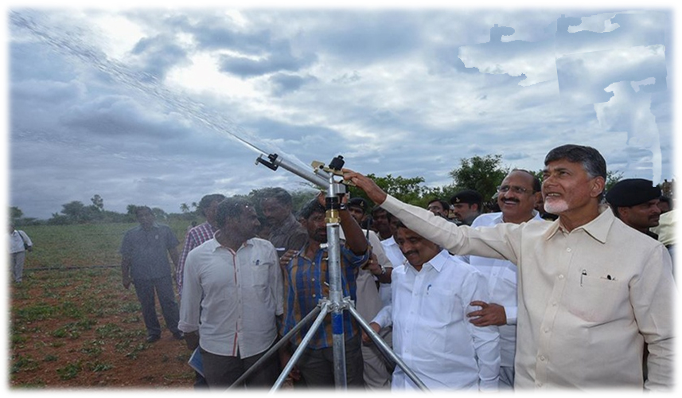
PANTA RAKSHANA

Slide 10
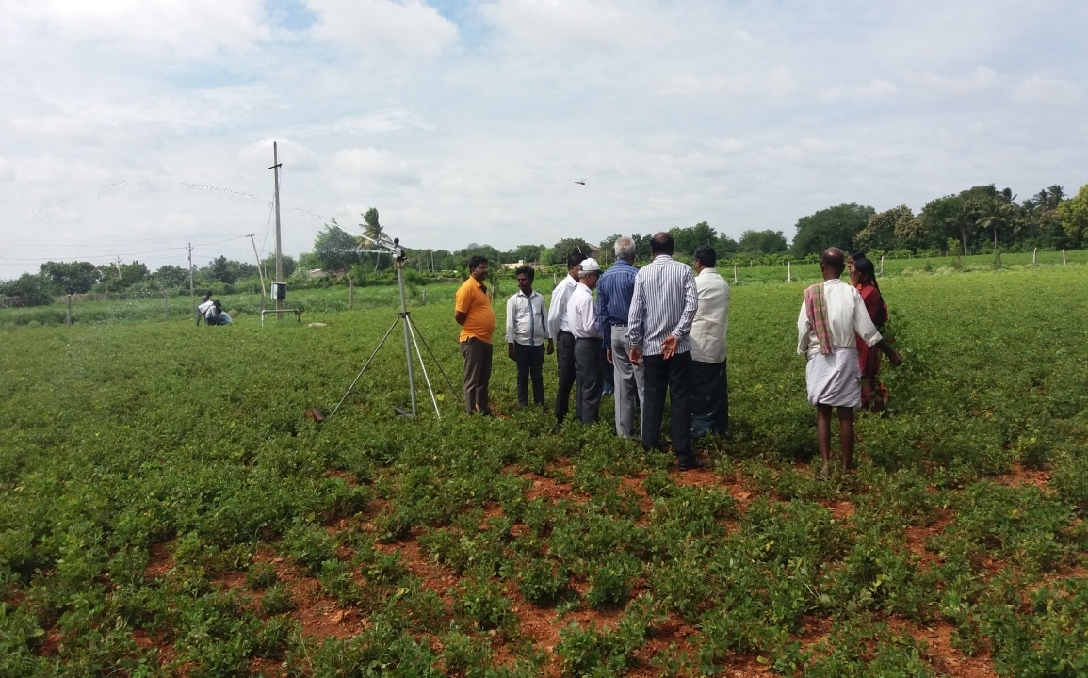
Field visit of Dr M. Dutta, National Consultant (Oil seeds) on 22-09-2016

Slide 11
DROUGHT PROOFING MEASURES
Panta Sanjeevani:
Water in farm ponds for dry spell mitigation.
Moisture Conservation Furrows:
Cover 1.30 lakh ha in roundnut, Redgram, Cotton, Blackgram, Maize etc., in rainfed areas.
Deep Ploughing:
To break hard pan in light soils and conserve more of rain water during monsoon deep ploughing with sub soilers is being promoted in 65,000 ha.
Contingency Plan:
Work shop conducted in coordination with CRIDA and ANGRAU scientists.
District wise contingency plan prepared.
Ground Water Collectivization:
Collectivization of ground water through
linking of bore wells, sharing of the water amongst the farmers.
Imposing ban on excavation of new bore wells .
The technology is adopted in 1000 ha in Ananthapur district and 500 ha each in Chittoor and Kurnool districts.

Slide 12
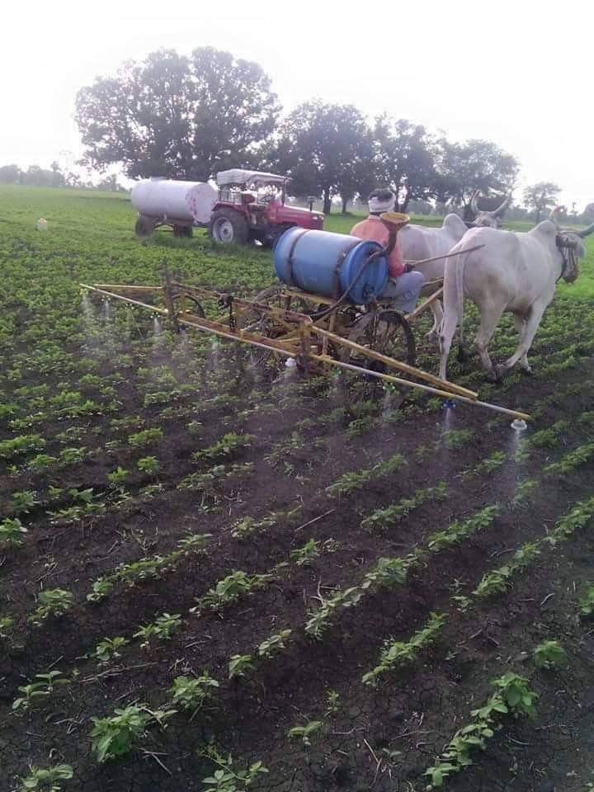
Providing protective irrigation
Rain gun
Tank irrigation with bullocks

Slide 13
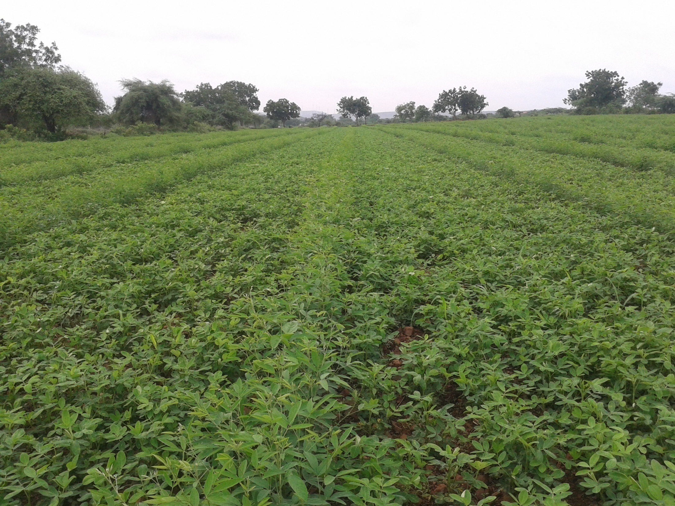
THANK YOU

