Slide 1
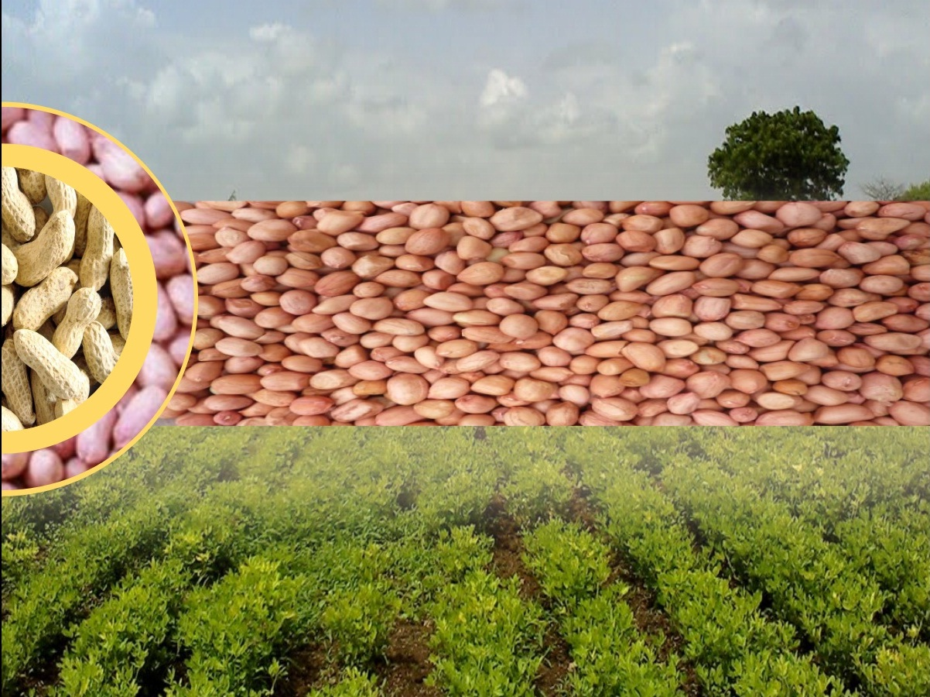
Standing Committee (SC) Meeting
4th August, 2016, 16:00hrs
Agenda 8:Presentation by the States on implementation of NMOOP
Directorate of Agriculture
Gujarat, India

Slide 2
LAND UTILIZATION
Total Geographical Area : 196 lakh hectares
Net Area Sown : 90 lakh hectares
Total Cropped Area : 139 lakh hectares
Gross Irrigated area : 44.71 %
Net Irrigated area : 43.24 %
Total Operational land holder : 48.86 lakh
Average land holding : 2.03 ha

Slide 3
AGRO CLIMATIC ZONE
Agro climatic zone | Type of soil | Rain fall (mm)
South Gujarat (Heavy Rain Area). | Deep black with few patches of coastal alluvial, laterite and medium black | 1500 and more
South Gujarat | Deep black clayey | 1000-1500
Middle Gujarat | Deep black, medium black to loamy sand | 800-1000
North Gujarat | Sandy loam to sandy | 625-875
Bhal & Coastal Area | Medium black, poorly drained and saline | 625-1000
South Saurashtra | Shallow medium black calcareous | 625-750
North Saurashtra | Shallow medium black | 400-700
North West Zone | Sandy and saline | 250-500

Slide 4
Rain fall status of Kharif 2016 in Gujarat
Month | Cumulative Total Rain fall of month(mm) | % Against Avg. Rain | Avg. Rain (mm) (1986-2015)
JUNE (up to 30-06-16) | 36.76 | 4.61 | 797
JULY (up to 31-07-16) | 261.06 | 32.75
AUGUST (up to 1-08-16) | 282.06 | 35.39

Slide 5
Percent Area of Oilseeds in Gujarat State

Slide 6
GROUNDNUT SCENARIO IN GUJARAT
Note: “Krushi karman Award” for highest oilseed production and productivity in the year 2013-14

Slide 7
Area covered during Kharif-2016 as on date: 01-08-2016
(Area in '000 ha)
Crop | Normal Area Last three year average | Area of Previous Kharif 2015 | Progressive Area of Kharif 2016 | % over Normal Area
Groundnut | 1393.8 | 1265.6 | 1539.5 | 110.45
Sesamum | 139.1 | 74.7 | 67.2 | 48.31
Soybean | 82.7 | 85.7 | 125.7 | 152.00
Castor | 714.4 | 29.0 | 23.5 | 3.29
Other Oilseed | 7.3 | 6.5 | 2.7 | 36.99
Total Oilseeds | 2337.3 | 1461.5 | 1758.6 | 75.24

Slide 8
Ground varieties in Gujarat
Varieties (>15 yrs) | Releasing Year | Varieties (<15 yrs) | Releasing Year
GAUG-10 | 1983 | G.G.-7 | 2002
G.G.-2 | 1983 | TAG-37A | 2004
G.G.-11 | 1985 | TPG-41 | 2004
G.G.-20 | 1991 | GJG-HPS-1 | 2009
TAG-24 | 1992 | GJG-9 | 2010
G.G.-5 | 1997 | GJG-31 | 2010
 |  | GJG-17 | 2011
 |  | GJG-22 | 2011

Slide 9
Grant detail statement for 2015-16 Gujarat state
(Rs. In lakh)
Category | Revalidated Unspent balance As of 2014-15 | Funds Released | Total Availability | Expenditure | Unspent balance on 01.04.2016
SC | 867.73377 | 0 | 867.73377 | 9.704 | 858.02977
ST | 405.44147 | 0 | 405.44147 | 35.89 | 369.55147
General M-I | 55.85372 | 624.4932 | 680.34692 | 911.956 | -231.60908
General MM-II | 73.239 | 22.4489 | 95.68790 | 95.687 | 0.0009
Total General | 129.09272 | 646.94210 | 776.03482 | 1007.64300 | -231.60818
Grand Total | 1402.26796 | 646.94210 | 2049.21006 | 1053.23700 | 995.97306

Slide 10
Physical & Financial Target and Achievement under NMOOP-Oilseeds Monthly Progress Report of March -2016 (Final)
State :- Gujarat |  |  |  |  |  |  |  |  |  | Financial:- Rs. In Lakh
Sr. | Component | Unit | Total Target |  |  |  | Total Achievement |  |  |  |  |  |  |  | %
 |  |  | Physical | Financial |  |  | Physical |  |  |  | Financial
 |  |  |  | GOI | STATE | TOTAL
 |  |  |  |  |  |  | Gen | SC | ST | Total | Gen | SC | ST | Total
1 | Purchase of Breeder seed | Qtls. | 1200 | 75.00 | 50.00 | 125.00 | 1191.53 | 0 | 0 | 1191.5 | 177.440 | 0.00 | 0.00 | 177.4402 | 141.95
2 | Prod. of Foundation seed | Qtls. | 759 | 4.55 | 3.04 | 7.59 | 385 | 0 | 0 | 385 | 3.845 | 0.00 | 0.00 | 3.8445 | 50.65
3 | Production of certified seed | Qtls. | 7583 | 45.50 | 30.33 | 75.83 | 9152 | 0 | 0 | 9152 | 91.515 | 0.00 | 0.00 | 91.5151 | 120.68
4 | Distri. of Certi. Seed | Qtls. | 22216 | 231.46 | 154.32 | 385.78 | 5043.6 | 55.97 | 66.11 | 5165.7 | 87.961 | 1.35 | 1.24 | 90.55494 | 23.47
5 | seed infrastructure development
Total seed Component (1 to 5 ) |  |  | 31758 | 356.51 | 237.69 | 594.20 | 15772 | 56 | 66 | 15894 | 360.76 | 1.35 | 1.24 | 363.35 | 61.15
6 | Block Demonstration | Ha. | 7415 | 223.08 | 148.72 | 371.80 | 5734 | 193 | 387 | 6314 | 208.841 | 5.50 | 15.27 | 229.6043 | 61.75
7 | B.D.Polymulch in G'nut | Ha. | 80 | 5.52 | 3.68 | 9.20 | 0 | 0 | 0 | 0 | 0.000 | 0.00 | 0.00 | 0 | 0.00
8 | IPM Demonstration(FFS) | Nos. | 458 | 73.37 | 48.91 | 122.28 | 61 | 0 | 0 | 61 | 9.437 | 0.00 | 0.00 | 9.43662 | 7.72
9 | Farmers Training | Nos. | 334 | 48.10 | 32.06 | 80.16 | 282 | 1 | 55 | 338 | 59.750 | 0.29 | 11.91 | 71.95394 | 89.76
10 | Officer training | Nos. | 17 | 3.67 | 2.45 | 6.12 | 14 | 1 | 0 | 15 | 4.390 | 0.31 | 0.00 | 4.70409 | 76.86
11 | Mission Management Expenses |  | 0 | 15.91 | 10.61 | 26.52 | 0 | 0 | 0 | 0 | 1.512 | 0.00 | 0.00 | 1.51171 | 5.70
Total of Transfer of Technology (6 o 11) |  |  | 8304 | 369.65 | 246.43 | 616.08 | 6091 | 195 | 442 | 6728 | 283.93 | 6.10 | 27.18 | 317.21 | 51.49

Slide 11
State :- Gujarat |  |  |  |  |  |  |  |  |  | Financial:- Rs. In Lakh
Sr. | Component | Unit | Total Target |  |  |  | Total Achivement |  |  |  |  |  |  |  | %
 |  |  | Physical | Financial |  |  | Physical |  |  |  | Financial
 |  |  |  | GOI | STATE | TOTAL
 |  |  |  |  |  |  | Gen | SC | ST | Total | Gen | SC | ST | Total
12 | Distribution Gypsum/Pyrite/liming/dolomite/SSP | Ha. | 45000 | 202.500 | 135.000 | 337.50 | 49715 | 120 | 490 | 50325 | 372.866 | 0.89 | 3.69 | 377.44 | 111.83
13 | Rhizobium/PSB culture | Ha. | 5022 | 9.040 | 6.030 | 15.07 | 1184 | 26 | 325 | 1535 | 3.552 | 0.08 | 0.98 | 4.61 | 30.56
14 | P.P.Chemicals /insecticides/Biopesticides | Ha. | 6700 | 20.100 | 13.400 | 33.50 | 4143 | 41 | 486 | 4670 | 20.708 | 0.20 | 2.43 | 23.34 | 69.67
 | Micro nutrient |  | 833 | 2.500 | 1.670 | 4.17 | 618 | 7 | 27 | 652 | 3.083 | 0.03 | 0.14 | 3.25 | 77.86
15 | NPV | Ha. | 375 | 1.130 | 0.750 | 1.88 | 0 | 0 | 0 | 0 | 0.000 | 0.00 | 0.00 | 0.00 | 0.00
16 | P.P.Equipments
 | Manully Operated | Nos. | 2262 | 9.50 | 6.33 | 15.83 | 0 | 0 | 0 | 0 | 0.000 | 0.00 | 0.00 | 0.00 | 0.00
 | Power Operated | Nos. | 303 | 9.09 | 6.06 | 15.15 | 133 | 2 | 0 | 135 | 3.990 | 0.02 | 0.00 | 4.01 | 26.44
17 | Impr. Farm Implements-total |  |  | 0.08 |  |  |  |  |  | 0 |  |  |  | 0.00
 | Manual | Nos. | 733 | 35.18 | 23.46 | 58.64 | 102 | 3 | 0 | 105 | 7.010 | 0.25 | 0.00 | 7.26 | 12.38
 | Power Operated | Nos. | 400 | 151.20 | 100.80 | 252.00 | 608 | 9 | 74 | 691 | 123.609 | 3.32 | 18.95 | 145.88 | 57.89
18 | Seed storage bins | Nos. | 1833 | 11.00 | 7.33 | 18.33 | 0 | 0 | 0 | 0 | 0.000 | 0.00 | 0.00 | 0.00 | 0.00
19 | Sprinkler sets | Ha. | 1075 | 132.97 | 88.64 | 221.61 | 1495 | 4 | 1 | 1500 | 149.500 | 0.40 | 0.10 | 150.00 | 67.69
20 | Pipes for supplying water | Unit of 600m | 1250 | 112.50 | 75.00 | 187.50 | 212 | 4 | 24 | 240 | 14.488 | 0.21 | 1.01 | 15.71 | 8.38
21 | Oil Engine | Nos. | 453 | 35.23 | 23.49 | 58.72 | 397 | 9 | 0 | 406 | 51.604 | 1.11 | 0.00 | 52.71 | 89.77
22 | Submersible Pump | Nos. | 173 | 25.95 | 17.30 | 43.25 | 246 | 2 | 5 | 253 | 31.970 | 0.20 | 0.50 | 32.67 | 75.55
23 | Electric Motor | Nos. | 420 | 34.93 | 23.29 | 58.22 | 209 | 4 | 0 | 213 | 25.630 | 0.40 | 0.00 | 26.03 | 44.71
24 | Tarpaulin | Nos. | 9600 | 72.00 | 48.00 | 120.00 | 5378 | 130 | 289 | 5797 | 67.225 | 1.62 | 3.61 | 72.45 | 60.37
Total of production inputs (12 to 24 ) |  |  |  | 864.90 | 576.55 | 1441.37 | 64440 | 361 | 1721 | 66522 | 875.236 | 8.72 | 31.40 | 915.35 | 63.51
 | Grand Total |  | 116494 | 1591.06 | 1060.67 | 2651.65 | 86303 | 612 | 2229 | 89144 | 1519.92 | 16.1735 | 59.81 | 1595.92 | 60.19

Slide 12
Annual Action Plan NMOOP-MM-I for 2016-2017
Sr. No. | Item/ Component | Financial Allocation (Rs. in Lakh)
 |  | GOI Share | State Share | Total
1 | Seed Component | 1162.68 | 775.12 | 1937.80
2 | TOT Programmes | 930.24 | 620.16 | 1550.40
3 | Production inputs | 387.60 | 258.40 | 646.00
4 | Farm Mechanization and Irrigation tools | 968.89 | 645.92 | 1614.81
5 | Provision for flexi-funds-activity wise targets & allocation | 387.36 | 258.24 | 645.60
6 | Mission Management Expenses | 39.23 | 26.16 | 65.39
Total allocation |  | 3876.00 | 2584.00 | 6460.00

Slide 13
Constraints in Groundnut Production
1.Ground nut is major growing oilseeds crop of Gujarat. Seed rate of Ground nut crop is very high, whereas seed replacement ratio is very low, Hence seed vigor is reduced in Ground nut. 2.Goundnut is highly susceptible to moisture stress, when more than 60% of groundnut area sown under rain fed condition. 3. In seed distribution & block demonstration component Government of India has given age relaxation from 10 years to 15 years old variety , but availability of certified seed of newer varieties with seed corporation is not enough to cover the targets under scheme. 4. In block demonstration for poly mulch in groundnut component plastic mixed with fodder to make it unusable to cattle where as bio degradable plastic cost is very high so farmers do not adopt it.

Slide 14
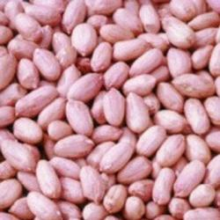
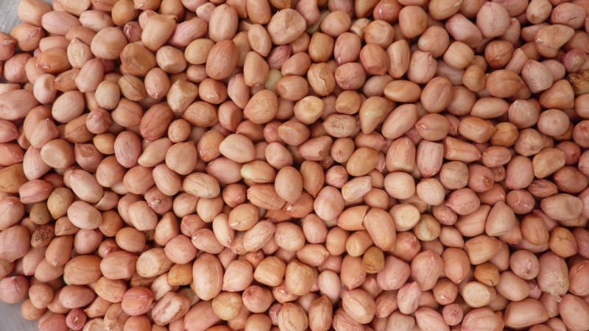
Thank you

